Slide 1

ME 362 VIBRATIONS I
Lecture 3
VIBRATION OF TWO-DEGREE-OF-FREEDOM SYSTEMS
Faisal Wahib Adam
Mechanical Engineering Department, KNUST

Slide 2

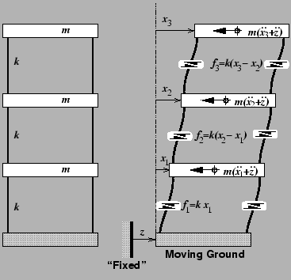
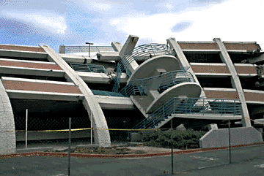
Models

Slide 3
Systems with more than one degree of freedom
Many real systems can be represented by a single degree of freedom model.
However, most actual systems have several bodies and several restraints and therefore several degrees of freedom.
Since no body is completely rigid, and no spring is without mass, every real system has more than one degree of freedom, and sometimes it is not sufficiently realistic to approximate a system by a single degree of freedom model.
Thus, it is necessary to study the vibration of systems with more than one degree of freedom.

Slide 4
General Solution-Free Undamped Systems

Slide 5
General Solution-Forced Damped Systems

Slide 6
General Solution

Slide 7
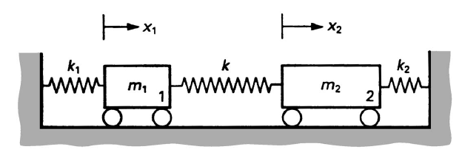
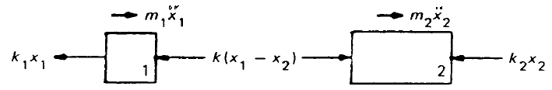


Vibration of two-degree-of-freedom systems
$m_{1}{\ddot{x}}_{1}+\left(k_{1}+k\right)x_{1}−kx_{2}=0$
$$m_{2}{\ddot{x}}_{2}−kx_{1}+\left(k+k_{2}\right)x_{2}=0$$
$$x_{1}=Asin(ωt+∅);{ x}_{2}=Bsin(ωt+∅)$$
$${\ddot{x}}_{1}=−ω^{2}x_{1};{\ddot{x}}_{2}=−ω^{2}x_{2}$$

Slide 8
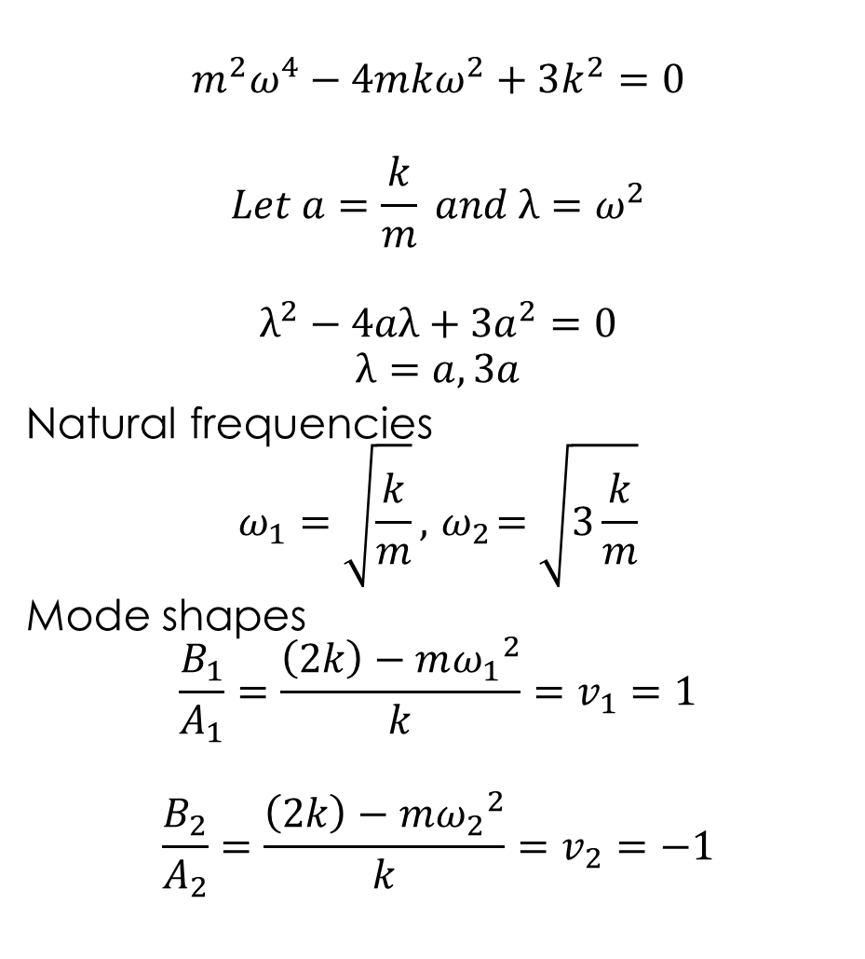
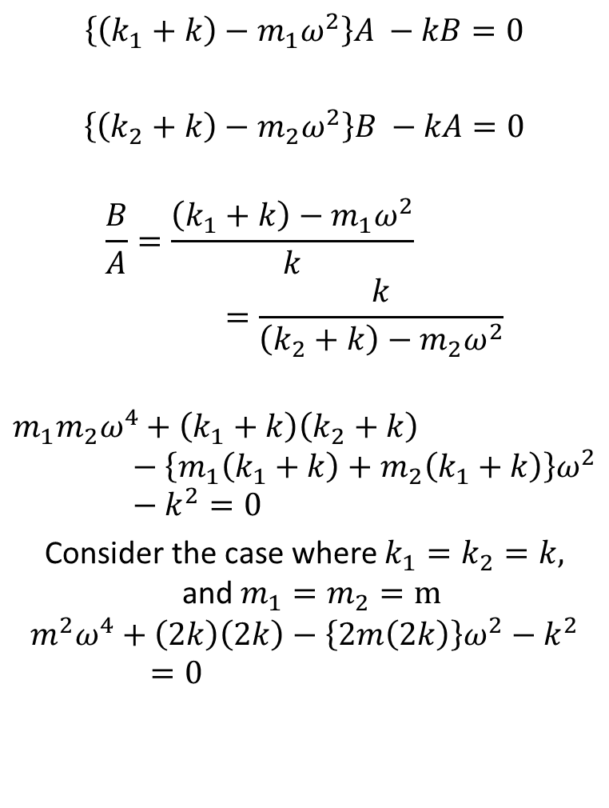
Solution cont’d Algebraic Method
$$m^{2}ω^{4}−4mkω^{2}+3k^{2}=0$$
$$Let a=\frac{k}{m} and λ=ω^{2}$$
$$λ^{2}−4aλ+{3a}^{2}=0$$
$$λ=a, 3a$$
Natural frequencies
$$ω_{1}=\sqrt{\frac{k}{m}},{ ω}_{2}=\sqrt{3\frac{k}{m}}$$
Mode shapes
$$\frac{B_{1}}{A_{1}}=\frac{\left(2k\right)−{mω_{1}}^{2}}{k}=v_{1}=1$$
$$\frac{B_{2}}{A_{2}}=\frac{\left(2k\right)−{mω_{2}}^{2}}{k}=v_{2}=−1$$
$\left\{\left(k_{1}+k\right)−{m_{1}ω}^{2}\right\}A −kB=0$
$\left\{\left(k_{2}+k\right)−m_{2}ω^{2}\right\}B −kA=0$
$$\frac{B}{A}=\frac{\left(k_{1}+k\right)−{m_{1}ω}^{2}}{k}=\frac{k}{\left(k_{2}+k\right)−{m_{2}ω}^{2}}$$
$$m_{1}{m_{2}ω}^{4}+\left(k_{1}+k\right)\left(k_{2}+k\right)−\left\{m_{1}\left(k_{1}+k\right)+m_{2}\left(k_{1}+k\right)\right\}ω^{2}−k^{2}=0$$
Consider the case where $k_{1}=k_{2}=k,$and $m_{1}=m_{2}=m$
$$m^{2}ω^{4}+\left(2k\right)\left(2k\right)−\left\{2m\left(2k\right)\right\}ω^{2}−k^{2}=0$$

Slide 9
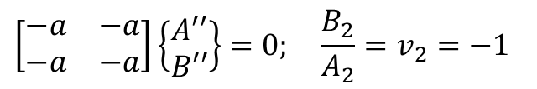




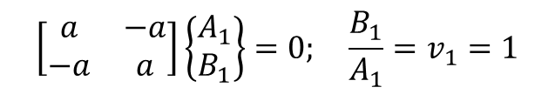
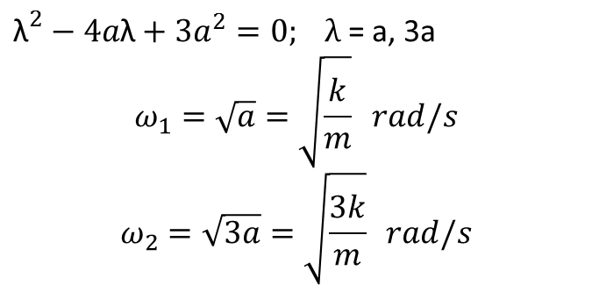
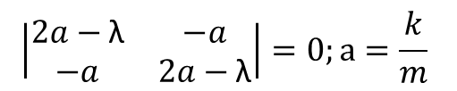
Solution cont’d Matrix Method
$$\left|\begin{matrix}2a−\text{λ} & −a \\ −a & 2a−\text{λ}\end{matrix}\right|=0;a=\frac{k}{m}$$
$\left[\begin{matrix}m_{1} & 0 \\ 0 & m_{2}\end{matrix}\right]\left\{\begin{matrix}{\ddot{x}}_{1} \\ {\ddot{x}}_{2}\end{matrix}\right\}+\left[\begin{matrix}k_{1}+k & −k \\ k & k+k_{2}\end{matrix}\right]\left\{\begin{matrix}x_{1} \\ x_{2}\end{matrix}\right\}=0$
Let λ=$ω^{2}$
${\text{λ}}^{2}−4a\text{λ}+3a^{2}=0; λ$ = a, 3a
$$ω_{1}=\sqrt{a}=\sqrt{\frac{k}{m}} rad/s$$
$$ω_{2}=\sqrt{3a}=\sqrt{\frac{3k}{m}} rad/s$$
$$\left[\begin{matrix}{(k}_{1}+k)−{\text{λ}m}_{1} & −k \\ k & \left(k+k_{2}\right)−{\text{λ}m}_{2}\end{matrix}\right]\left\{\begin{matrix}x_{1} \\ x_{2}\end{matrix}\right\}=0$$
$$\left|\begin{matrix}\frac{k_{1}+k}{m_{1}}−\text{λ} & \frac{−k}{m_{1}} \\ \frac{−k}{m_{2}} & \frac{k_{2}+k}{m_{2}}−\text{λ}\end{matrix}\right|=0$$
Consider the case when $k_{1}=k_{2}=k,$and $m_{1}=m_{2}=m$
$$\left|\begin{matrix}\frac{2k}{m}−\text{λ} & \frac{−k}{m} \\ \frac{−k}{m} & \frac{2k}{m}−\text{λ}\end{matrix}\right|=0$$
Eigen vectors/Mode shapes
$${\text{λ}=\text{λ}}_{1}=a$$
$$\left[\begin{matrix}a & −a \\ −a & a\end{matrix}\right]\left\{\begin{matrix}A_{1} \\ B_{1}\end{matrix}\right\}=0; \frac{B_{1}}{A_{1}}=v_{1}=1$$
$${\text{λ}=\text{λ}}_{2}=3a$$
$$\left[\begin{matrix}−a & −a \\ −a & −a\end{matrix}\right]\left\{\begin{matrix}A′′ \\ B′′\end{matrix}\right\}=0; \frac{B_{2}}{A_{2}}=v_{2}=−1$$

Slide 10
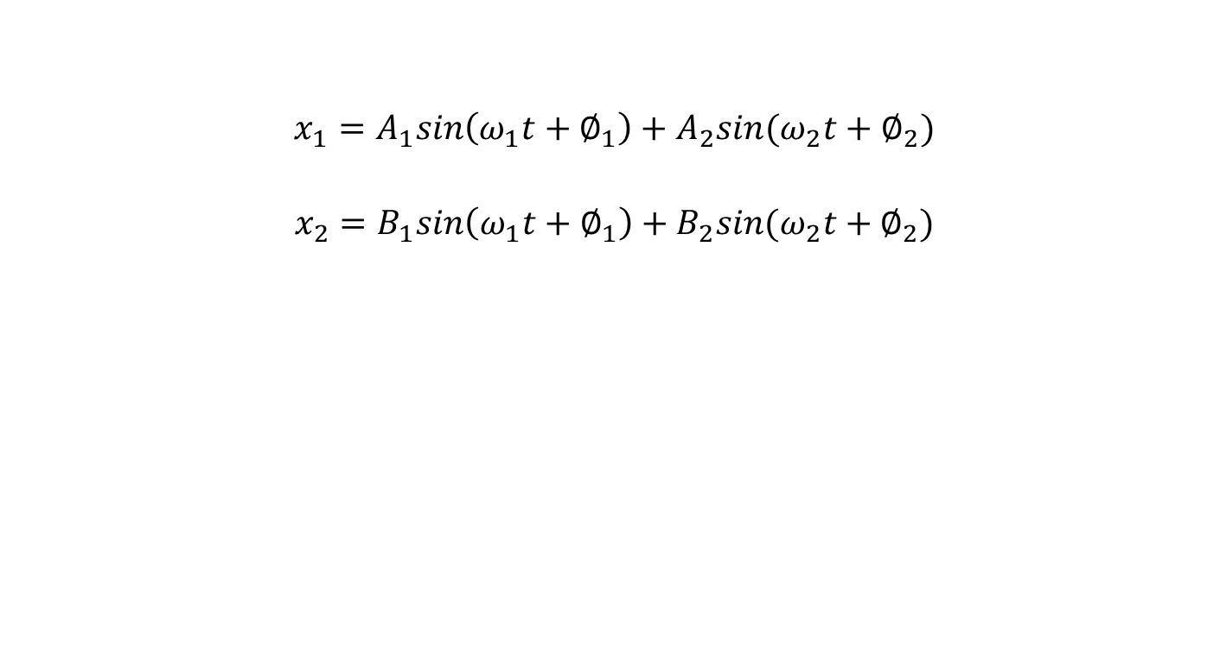
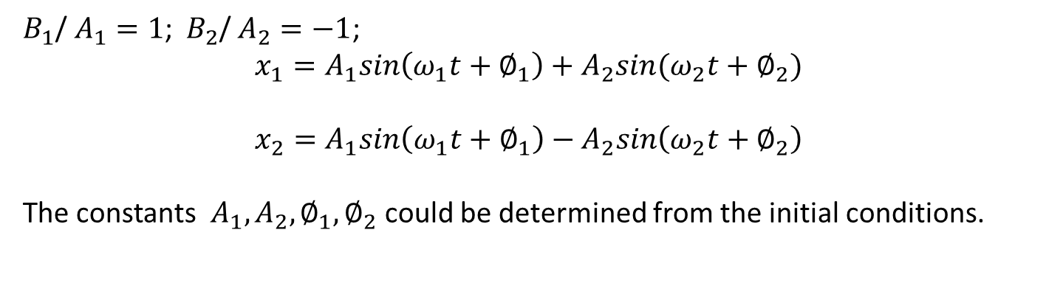
Solution cont’d General solutions
$$x_{1}=A_{1}sin\left(ω_{1}t+∅_{1}\right)+A_{2}sin(ω_{2}t+∅_{2})$$
$$x_{2}=B_{1}sin\left(ω_{1}t+∅_{1}\right)+B_{2}sin(ω_{2}t+∅_{2})$$
$B_{1}$/ $A_{1}=1$;${ B}_{2}$/ $A_{2}=−1$;
$$x_{1}=A_{1}sin\left(ω_{1}t+∅_{1}\right)+A_{2}sin(ω_{2}t+∅_{2})$$
$$x_{2}=A_{1}sin\left(ω_{1}t+∅_{1}\right)−A_{2}sin\left(ω_{2}t+∅_{2}\right)$$
The constants $A_{1},A_{2}, ∅_{1},∅_{2}$ could be determined from the initial conditions.

Slide 11
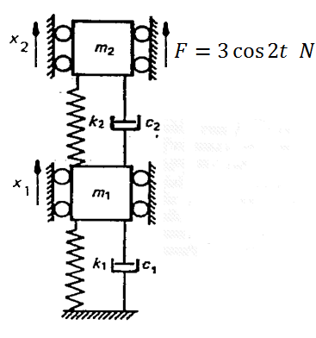
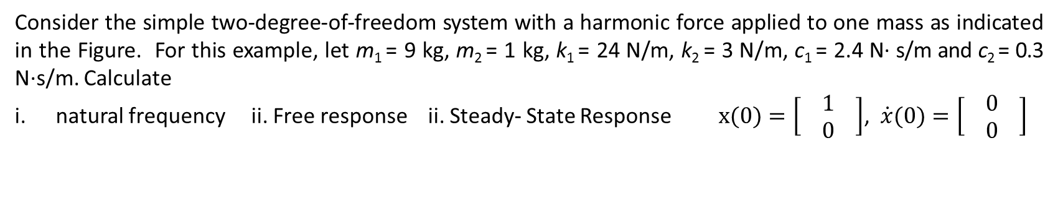
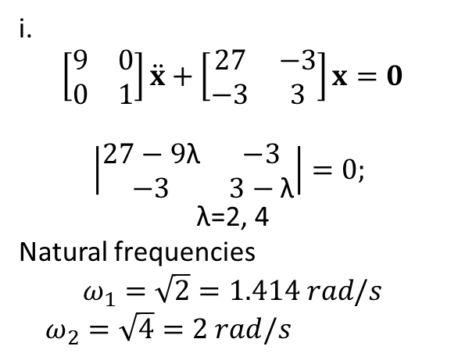
Example 2
Consider the simple two-degree-of-freedom system with a harmonic force applied to one mass as indicated in the Figure. For this example, let m₁ = 9 kg, m₂ = 1 kg, k₁ = 24 N/m, k₂ = 3 N/m, c₁ = 2.4 N· s/m and c₂ = 0.3 N·s/m. Calculate
natural frequency ii. Free response ii. Steady- State Response $x(0)=\left[\begin{matrix}1 \\ 0 \end{matrix}\right]$,$\dot{x}(0)=\left[\begin{matrix}0 \\ 0 \end{matrix}\right]$
F.B.D ? Equations of motion ?
$$\left[\begin{matrix}9 & 0 \\ 0 & 1\end{matrix}\right]\ddot{x}+\left[\begin{matrix}2.7 & −0.3 \\ −0.3 & 0.3\end{matrix}\right]\dot{x}+\left[\begin{matrix}27 & −3 \\ −3 & 3\end{matrix}\right]x=\left[\begin{matrix}0 \\ 3cos2t \end{matrix}\right]$$
i.
$$\left[\begin{matrix}9 & 0 \\ 0 & 1\end{matrix}\right]\ddot{x}+\left[\begin{matrix}27 & −3 \\ −3 & 3\end{matrix}\right]x=0$$
$$\left|\begin{matrix}27−\text{9}\text{λ} & −3 \\ −3 & 3−\text{λ}\end{matrix}\right|=0;$$
$$\text{λ}\text{=2, 4}$$
Natural frequencies
$$ω_{1}=\sqrt{2}=1.414 rad/s$$
$ω_{2}=\sqrt{4}=2 rad/s$

Slide 12
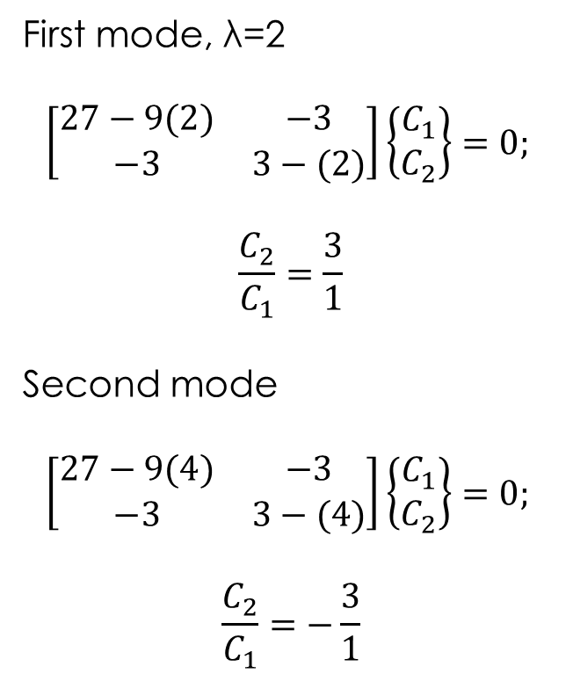
Free- Response
First mode, $\text{λ}\text{=}$2
$$\left[\begin{matrix}27−\text{9(2}) & −3 \\ −3 & 3−\text{(2)}\end{matrix}\right]\left\{\begin{matrix}C_{1} \\ C_{2}\end{matrix}\right\}=0;$$
$$\frac{C_{2}}{C_{1}}=\frac{3}{1}$$
Second mode
$$\left[\begin{matrix}27−\text{9(}4) & −3 \\ −3 & 3−\text{(}\text{4}\text{)}\end{matrix}\right]\left\{\begin{matrix}C_{1} \\ C_{2}\end{matrix}\right\}=0;$$
$$\frac{C_{2}}{C_{1}}=−\frac{3}{1}$$

Slide 13
Steady- State Response

Slide 14
Solution

Slide 15
Solution

Slide 16
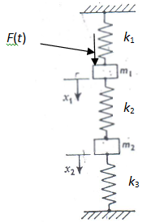
Assignment 1
The Figure shown, shows a system consisting of two bodies and three springs with a harmonic force
F (t) = 15 cos 3t kN, applied to one mass. Determine the natural frequencies of this system and calculate its steady-state response. Obtain the solution in the physical coordinate system x(t). Work from first principles using matrix methods.
Take m₁ =7 kg, m₂ =17kg, k₁ = 30 kN/m, k₂ = 20 kN/m, and k₃ = 16 kN/m, where k denotes spring constant. Assume zero initial conditions.

Slide 17
Assignment 2
Find the natural frequency and the Free response at zero initial conditions
of the system shown below

Slide 18
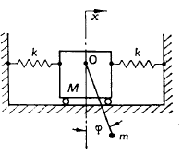
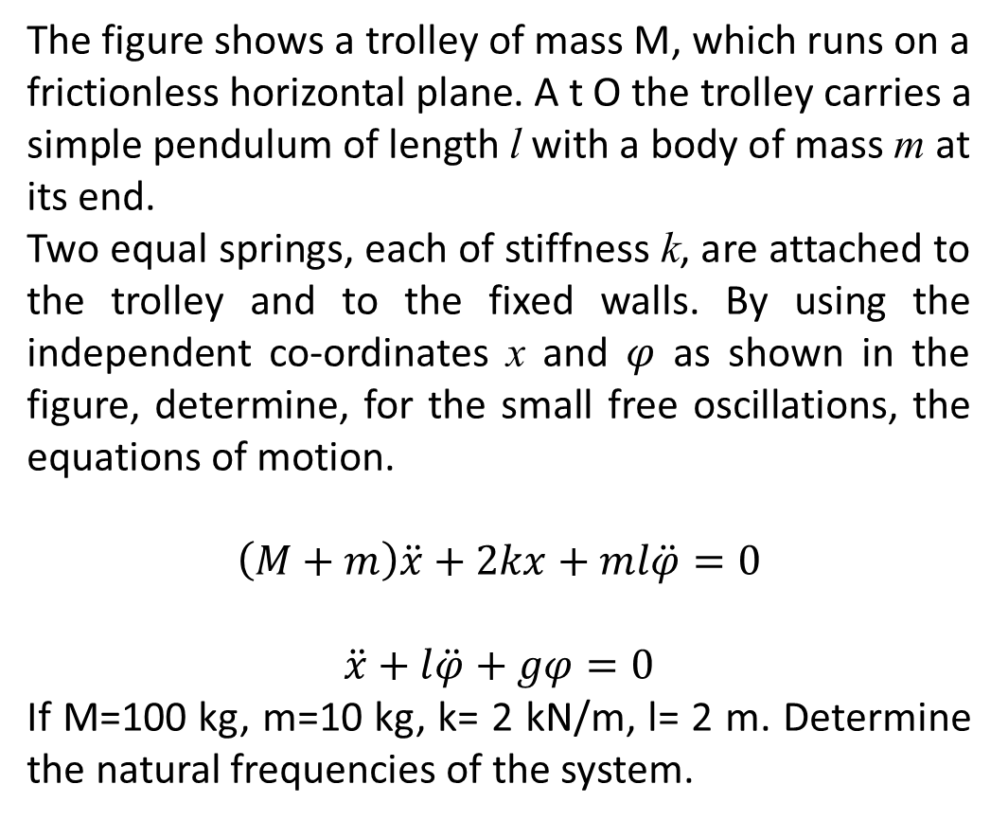
Assignment 3
The figure shows a trolley of mass M, which runs on a frictionless horizontal plane. A t O the trolley carries a simple pendulum of length l with a body of mass m at its end.
Two equal springs, each of stiffness k, are attached to the trolley and to the fixed walls. By using the independent co-ordinates x and $φ$ as shown in the figure, determine, for the small free oscillations, the equations of motion.
$$\left(M+m\right)\ddot{x}+2kx+ml\ddot{φ}=0$$
$$\ddot{x}+l\ddot{φ}+gφ=0$$
If M=100 kg, m=10 kg, k= 2 kN/m, l= 2 m. Determine the natural frequencies of the system.

